Slide 1
Bangladesh University of Professionals
Orientation Program
Of
MISS-2025
Organized by: Dept. of ICT, BUP
Date: 07/02/2025

Slide 2
Welcome
To BUP

Slide 3
Brief Introduction
of
MISS Program

Slide 4
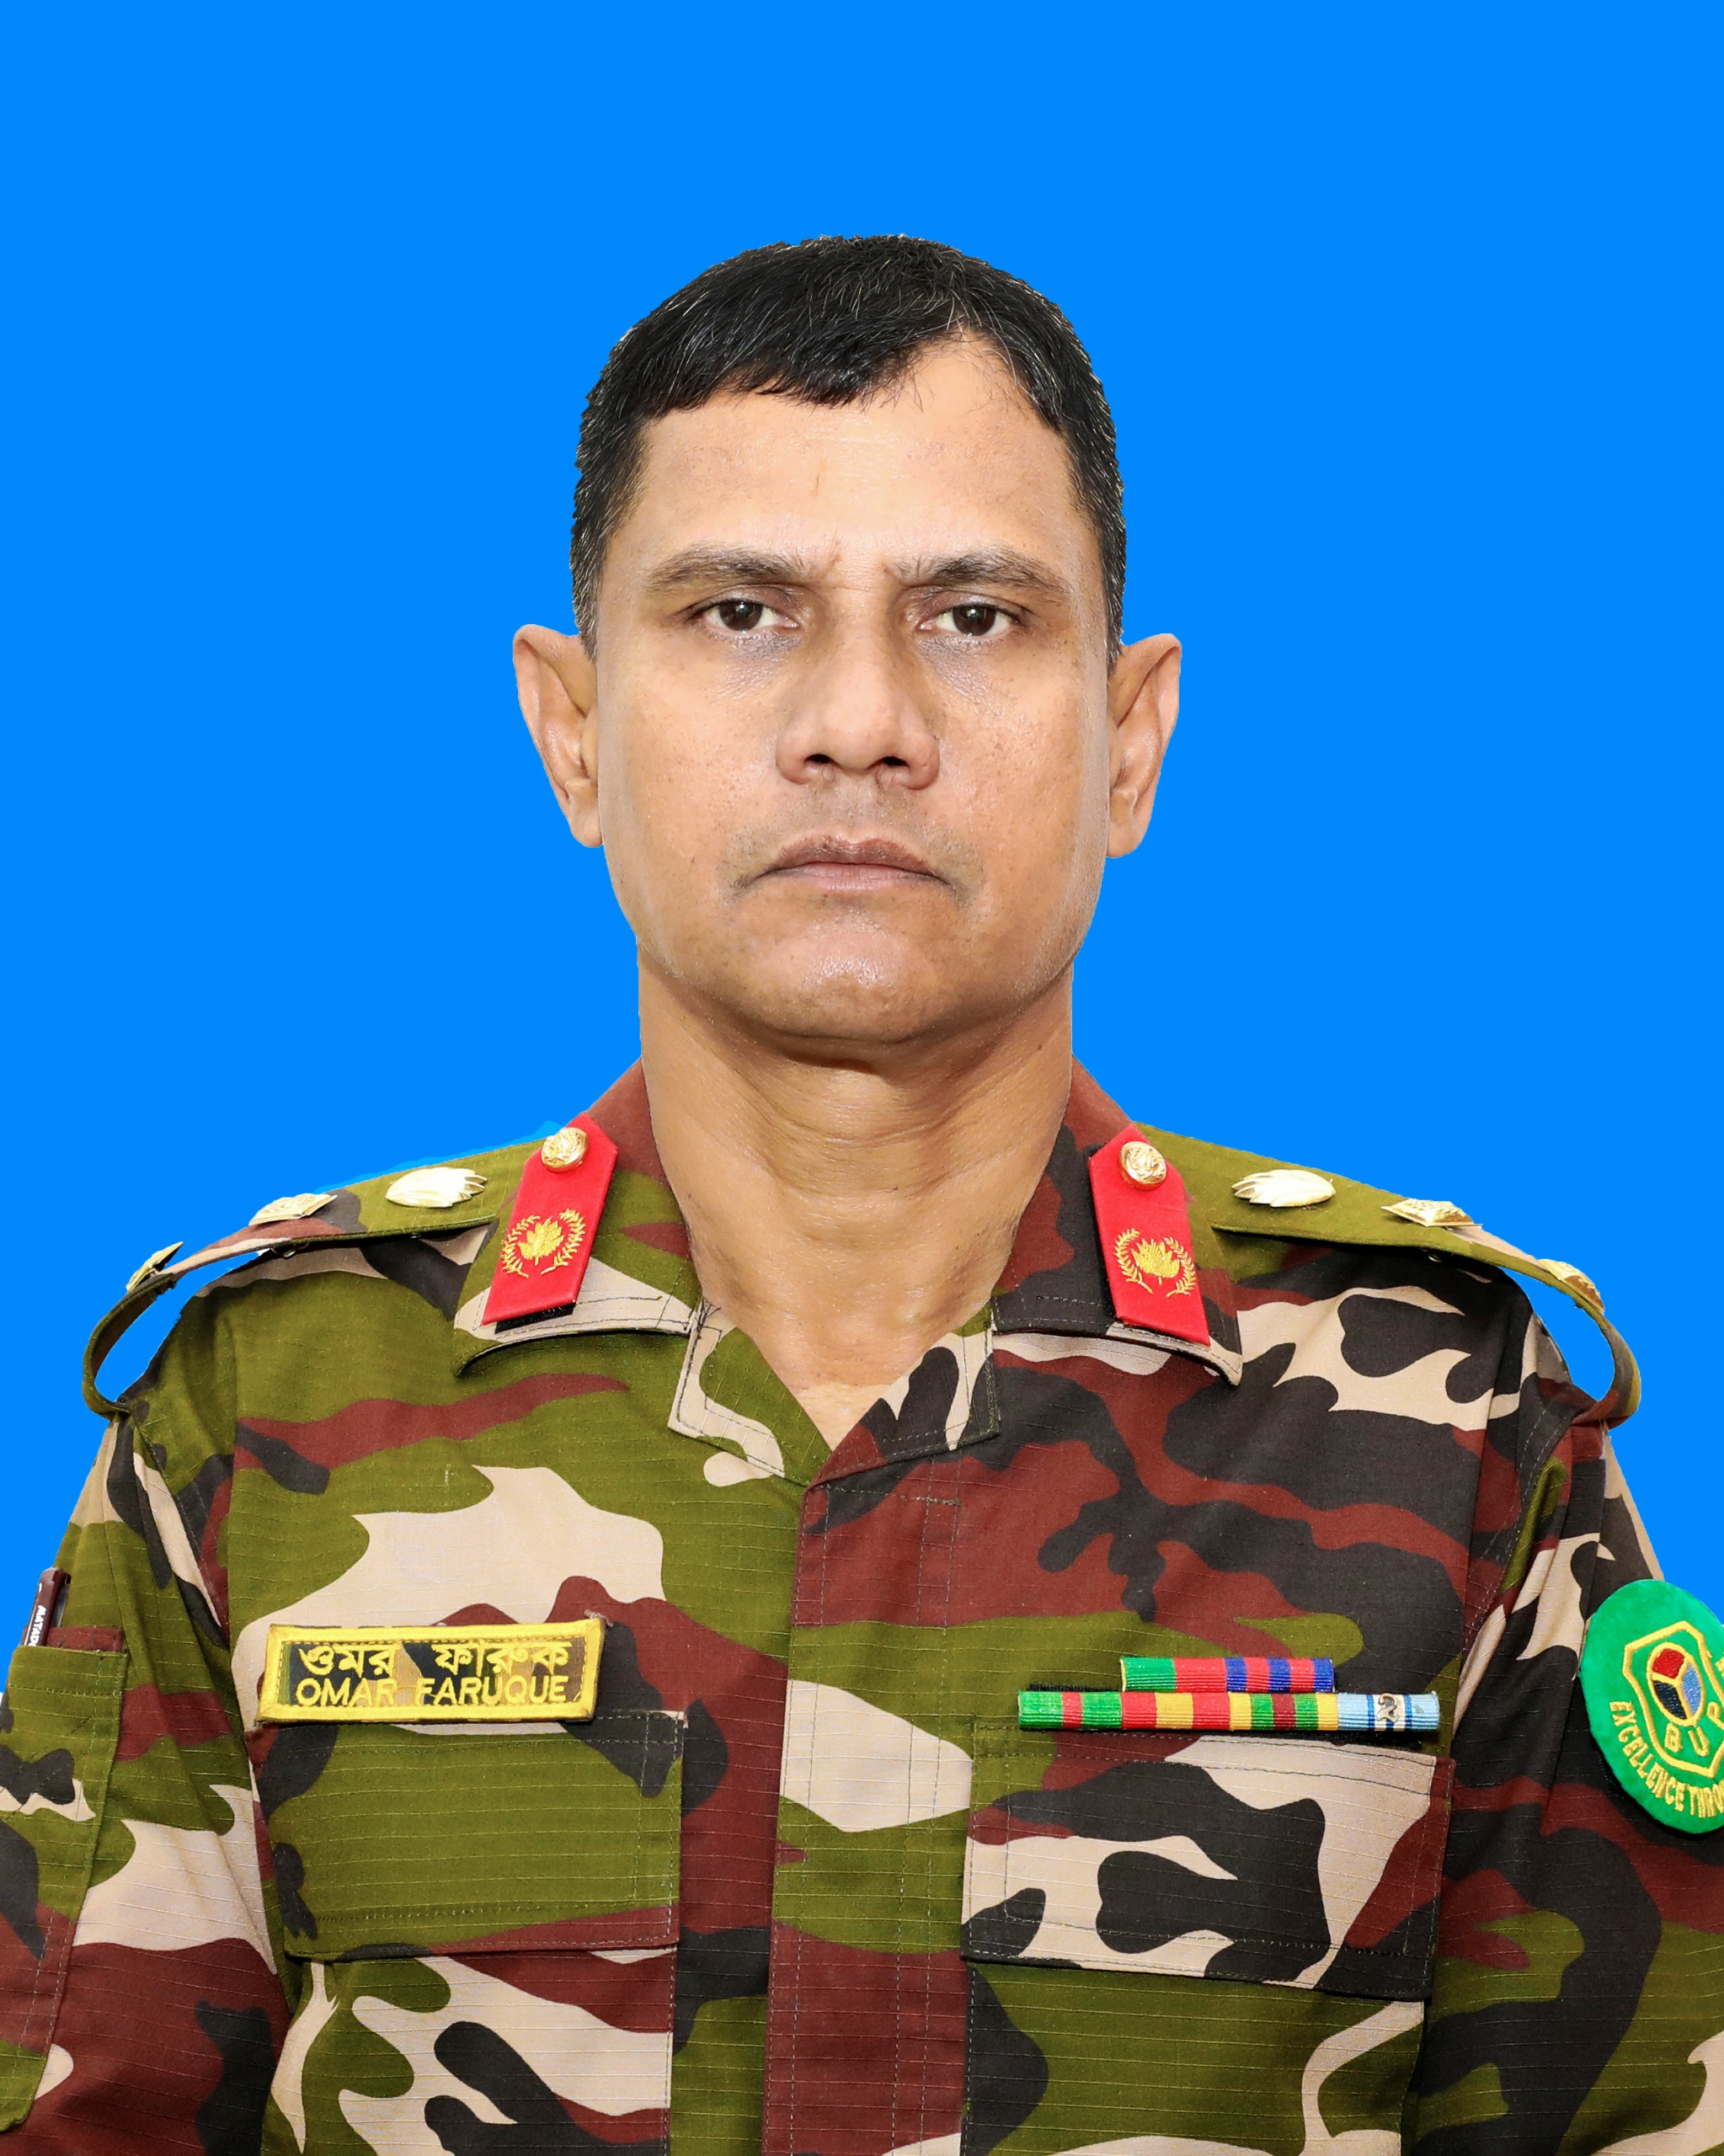
Program Director MISS Program
Colonel Mohammed Omar Faruque, PhD

Slide 5
Introduction of the Programs
Masters in Information Systems Security (MISS) has been conducted by the Department of ICT, under the Faculty of Science and Technology, since January 2015.

Slide 6
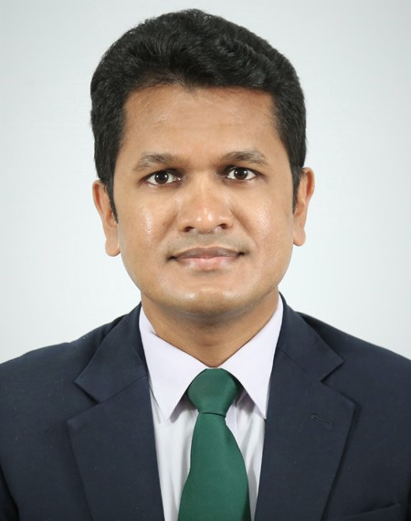
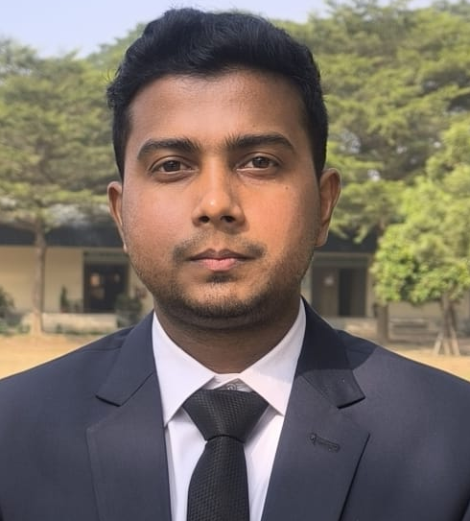
Program & Batch Coordinators
Asst. Prof. Md. Maynul Islam
Program Coordinator
Md. Mostafizur Rahman
Asst. Program Coordinator

Slide 7
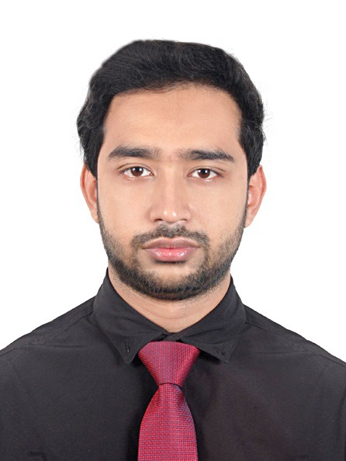
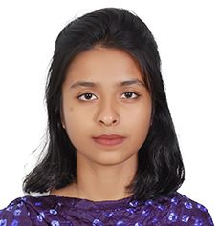
Program & Batch Coordinators
Lec. Md. Sazzadul Islam Prottasha
Batch Coordinator (MISS 2024)
Lec. Jasiya Fairiz Raisa
Batch Coordinator (MISS 2025)

Slide 8
Vision of the MISS Program
To develop a world-standard program on information systems security through advanced education and research that equips professionals to tackle evolving security challenges.

Slide 9
Mission of the MISS Program
To equip students with hands on knowledge and skills necessary to maximize students’ potentials with a view to preparing an individual specialist on information systems security.

Slide 10
Objectives of MISS Program
To equip students with in-depth knowledge of security protocols, encryption, and cybersecurity technologies to safeguard and defend computer systems and networks.
To foster hands-on skills in implementing secure network configurations and using industry-standard tools, such as firewalls, intrusion detection systems, and vulnerability scanners.
To prepare students to assess, mitigate, and manage risks associated with information systems, ensuring resilience against potential threats.
To investigate information systems security incidents and develop and implement solutions to recover or minimize the loss of information.
To prepare graduates to design, implement, and monitor comprehensive cybersecurity measures that protect critical information technology resources.

Slide 11
Information about the MISS Program
Subjects | M. Sc. Engineering |  | M. Engineering
Total Credits: 40 | Theory-22 cr. | Thesis-18 cr. | Theory-34 cr. | Project-06 cr.
Program Duration | 2 years (4 semesters) |  | 2 years (4 semesters)
Registration period | 4 yrs |  | 4 yrs
Number of Courses | 8 (22 Credits) |  | 12 (34 Credits)
Total Fees | 1,95,000 Tk. |  | 1,80,000 Tk.

Slide 12
Courses of MISS Program
 | Number of Courses (M. Sc. Engineering) | Number of Courses (M. Engineering)
First semester (Credit-09) | Principles of Information Security (3 Cr.) Secure Software Design (3 Cr.) Systems and Network Security (3 Cr.) | Principles of Information Security (3 Cr.) Secure Software Design (3 Cr.) Systems and Network Security (3 Cr.)
Second semester (Credit-10) | 4. Information Systems Audit (3 Cr.) 5. Penetration Testing (3 Cr.) 6. Research Methodology (1 Cr.) 7. Elective-I (3 Cr.) | 4. Information Systems Audit (3 Cr.) 5. Penetration Testing (3 Cr.) 6. Research Methodology (1 Cr.) 7. Elective-I (3 Cr.)
Third semester (M.Sc. Eng. Credit-12) (M. Eng. Credit-9) | 8. Elective- II (3 Cr.) MISS-6000: Thesis (9 Cr.) | 8. Elective II (3 Cr.) 9. Elective III (3 Cr.) 10. Elective IV (3 Cr.)
Fourth semester (M.Sc. Eng. Credits-9) (M.Sc. Eng. Credits-12) | MISS-6000: Thesis (9 Cr.) | 11. Elective V (3 Cr.) 12. Elective VI (3 Cr.) MISS 6001: Project (6 Cr.)

Slide 13
Attendance Policy
Attendance | Marks
85% and above | 10
75% to < 85% | 9
65% to < 70% | 8
55% to < 65% | 7
50% to < 55% | 6
Less than 50% | Dis-Collegiate

Slide 14
Academic Calendar
SL | SUBJECTS | WEEK | DURATION |  |  | OFFLINE/ONLINE | REMARKS
1 | January-June Semester Commences | Wk-1 | 07 Feb | -- | 08 Feb | Offline | Class Begins from 7th February 2025
2 |  | Wk-2 | 14 Feb | -- | 15 Feb | Offline | Shab-E-Barat
3 |  | Wk-3 | 21 Feb | -- | 22 Feb | Offline | International Mother Language Day
4 |  | Wk-4 | 28 Feb | -- | 01 Mar | Offline | Class Test-01
5 |  | Wk-5 | 07 Mar | -- | 08 Mar | Offline
6 |  | Wk-6 | 14 Mar | -- | 15 Mar | Offline | Class Test-02
7 |  | Wk-7 | 21 Mar | -- | 22 Mar | Offline
8 |  | Wk-8 | 28 Mar | -- | 29 Mar | Off day | Shab-E Qadr & Eid-Ul-Fitr
9 |  | Wk-9 | 04 Apr | -- | 05 Apr | Online
10 |  | Wk-10 | 11 Apr | -- | 12 Apr | Offline | Mid Term Exam (1st Week)

Slide 15
Academic Calendar
SL | SUBJECTS | WEEK | DURATION |  |  | OFFLINE/ONLINE | REMARKS
11 |  | Wk-11 | 18 Apr | -- | 19 Apr | Offline | Mid Term Exam (2nd Week)
12 |  | Wk-12 | 25 Apr | -- | 26 Apr | Offline
13 |  | Wk-13 | 02 May | -- | 03 May | Offline | Class Test-03
14 |  | Wk-14 | 09 May | -- | 10 May | Offline
15 |  | Wk-15 | 16 May | -- | 17 May | Offline | Class Test-04
16 |  | Wk-16 | 23 May | -- | 24 May | Offline
17 |  | Wk-17 | 30 May | -- | 31 May | Offline
18 |  | Wk-18 | 06 Jun | -- | 07 Jun | Off Day | Eid-Ul-Azha
19 | Semester Preparatory Leave Question Settings & Moderation | Wk-19 | 13 Jun | -- | 14 Jun | Online | Make Up Classes
20 |  | Wk-20 | 20 Jun | -- | 21 Jun | Offline | Semester Final Exam
21 |  | Wk-21 | 27 Jun | -- | 28 Jun | Offline | Semester Final Exam
22 |  | Wk-22 | 04 Jul | -- | 05 Jul | Offline | Semester Final Exam
23 | Result Preparation | Wk-23 | 11 Jul | -- | 12 Jul | -
24 |  | Wk-24 | 18 Jul | -- | 19 Jul

Slide 16
Promotion Policy
Serial | Graduate Program
 | Semester | Required Minimum CGPA
1 | 1st – 2nd | 2.50
2 | 2nd – 3rd | 2.50
3 | 3rd – 4th | 2.50

Slide 17
Promotion Policy
If a student gets ‘F’ grade in more than one (01) course in any semesters and/or fails to obtain required CGPA of 2.50 in a semester as mentioned above, he/she will automatically be relegated to the next batch, and such relegation more than twice entire the registration period will warrant permanent withdrawal of the student from the program.
However, besides the retaking courses obtaining ‘F’ Grade, the relegated student will also have the option to improve or retake for rest of the courses.

Slide 18
The Rules on Withdrawal
a. Temporary Withdrawal:
Temporary withdrawal means a student has voluntarily withdrawn himself/herself from a particular semester/trimester. A student will have to re-register their required courses by the next Semester/trimester with the next immediate batch.
b. Permanent Withdrawal:
The term “Permanent Withdrawal” means permanent, voluntary discontinuation from the program.
-the cancellation of admission and
-expiry of registration
c. Withdrawal on Poor Performance:
- Two times relegation
-Failing in any courses three times

Slide 19
Supplementary Exam
As a general rule, supplementary examinations of any kind are not allowed. In case of a student’s extreme compassionate ground the following steps are required:
apply (supporting documents) to the concerned Chairman of the department within seven days from the last examination
approved by the Chairman of the Department
appear the supplementary examination within 45 days of publishing the result of the semester final.
pay the required fees as per the university policy
No more than 'B' grade will be awarded to the students for supplementary examinations

Slide 20
Repeating/Retaking/ Improvement of Grade
Retaking:
-‘F’ grade or being dis-collegiate/Absent/Expelled in any course
-only 1 courses in each semester
-GPA Below B grade :
student must apply to the Chairman of the department within first week of the commencement of a semester.

Slide 21
Repeating/Retaking/ Improvement of Grade
Improvement :
‘Less than ‘B’
-previous result of that course will be nullified,
-GPA obtained in the improvement examination result will be considered as the final one
Scope: only once
Repeating:
Failing in a course twice will warrant a student to be permanently withdrawn from the program/BUP.
Note:
Improvement examination for a course is not allowed after the graduation.

Slide 22
Thesis/Project Policy
Department will decide on the basis of Semester results (CGPA>=3.25), Research work, and students’ Career plans, etc.
Individual Thesis/ Individual Project
Appointment of Supervisor and Co-supervisor
Research Proposal submission
Pre-defense
Publication is Mandatory for Thesis Students
Defense

Slide 23
Additional Payment/Fees (MISS)
Sl. | Subjects | Amount (Tk.)
1. | Re-admission | 10,000.00
2. | Non-Collegiate (per subject) | 5,000.00
5. | Late Registration Fee | 1,500.00
6. | Special Final Exam | 15,000.00
8. | Retake Course Fee | 12,000.00
9. | Supplementary Exam Fee | 8,000.00

Slide 24
Refund
All fees are non-refundable.
Only Security Money is refundable as per policy.
The 25% of the security money will be forfeited if a student opts to withdraw within 1st year of study after admission activities and the rest will be refunded on completion of 1st year.
If a student discontinues a semester temporarily for any valid reason, then under special consideration his/her Examination Fee, Computer Lab and Training Aid Fee, Student Welfare Fee and Center Fee may be waivered while recommencing that discontinued semester.

Slide 25
Readmission
If a student fails to clear dues within next one month of the stipulated time mentioned above, his/her name will be dropped. The student has to apply to Chairman, ICT for re-admission with necessary penalties and fees if he/she desires to continue.
A student may be dismissed or expelled from the program for adopting unfair means, unruly behavior, or any other breach of discipline.
Once a student is dismissed, he/she will require a readmission and fresh registration to re-participate in the program.

Slide 26
Code of Conduct
The students will not be allowed to enter the classroom, if he/she is in contrary to the following rules:
Arriving late in the class
Not wearing appropriate dress/attire as per the dress code
The Students' Discipline Rules are available in BUP website.

Slide 27
Requirements of Degree
Must not have any “F” grade
Must maintain a minimum CGPA of 2.50
Minimum grade in the Thesis/ Project/ is “C”.

Slide 28
Awarded Degrees by BUP
M. Sc. Engg/ M. Engg in Information Systems Security (MISS)

Slide 29
Thank You!

